Slide 1
Application Development Orienting – Week 7
arrays

Slide 2

Previously in ADO
Topics so far
Variables and operators
Selection
Repetition
Methods

Slide 3

Content
Topics of this week
Arrays
Learning objectives
Use arrays to store multiple data entries

Slide 4

Intro: Arrays
We sometimes need to store and access multiple elements
An array is an ordered sequence of variables of the same type
Referenced by the name of the array
Each variable can be accessed by the name of the array and an index

Slide 5

Syntax array
<type>[] <array_name>; //declare an array
<array_name> = new <type>[<array_size>];
// create an array big enough to store <array_size> elements;
// all elements initialized with bytes 0.
//assign elements to an array
<array_name>[<index>] = <value_of_same_type>;

Slide 6

Examples
double[] grades;
grades = new double[5]; // create an array to store 5 doubles
grades[0] = 7;
grades[1] = 5;
grades[2] = 8.4;
grades[3] = 9;
grades[4] = 6.5;
// elements of the array grades are 7, 5, 8.4, 9 and 6.5

Slide 7
Example (create and initialize an array)
String[] names = {"Sue", "Jane", "Bruce", "Wayne"};
// creates an array names, just big enough to store the elements as indicated between the curly brackets.
The array is initialized with the values as indicated between the curly brackets.
names
index | value
0 | "Sue"
1 | "Jane"
2 | "Bruce"
3 | "Wayne"

Slide 8
Example (cont.)
int[] numbers;
numbers = new int[7];
for(int i=0; i<7; i++)
{
numbers[i] = 2*(i+1);
}
numbers
index | value
0 | 2
1 | 4
2 | 6
3 | 8
4 | 10
5 | 12
6 | 14
int sum = 0 ; // suppose we have an array X
for(int i=0; i<20 ; i++)
{
sum = sum + X[i];
} // sum has value X[0] + X[1] + . . . + X[19]

Slide 9

Extra information
Methods and attributes
grades.Length : the number of elements of the array grades
Array.Sort(grades): sorts all elements of the array grades
The index in an array always starts at 0.
int sum = 0 ; // suppose we have an array X
for(int i=0; i < X.Length ; i++)
{
sum = sum + X[i];
} // sum has value X[0] + X[1] + . . . + X[???]

Slide 10
Extra information(cont.)
An array can be passed as an argument to a method
//a method with an array as parameter: public double Average (double[] numbers) { . . . }
double[] grades; grades = new double[5];
grades[0] = 7;
grades[1] = 5;
grades[2] = 8.4;
grades[3] = 9;
grades[4] = 6.5;
double avg = Average(grades);

Slide 11

Your turn!
Write an app that can store a list of 10 names.
Add controls to:
Add a name to the list, make sure an error message is shown if the list is full
Search the list for a given name, if it is found, show the index; if not, show a message.

Slide 12

Questions?

Slide 13
2

Slide 14
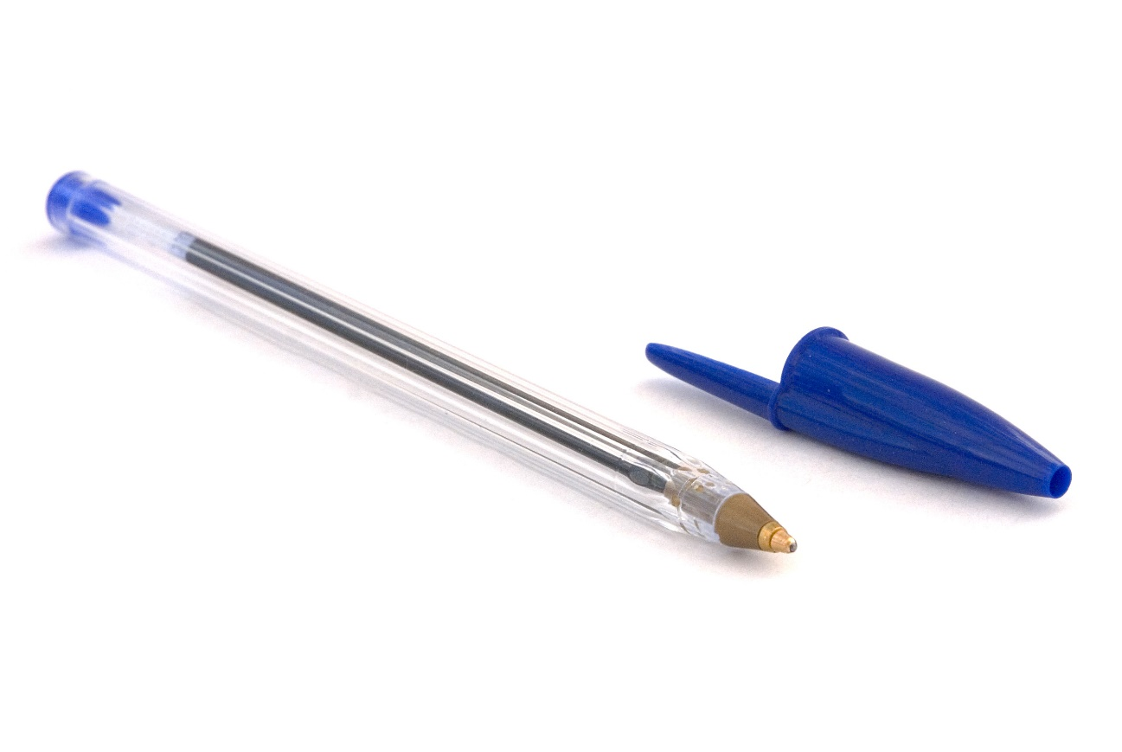
Review of last week’s test

Slide 15

Summary
Array to store and manipulate multiple data elements

Slide 16

What to do next?
Assignments week 7
Individual reviews of week 6 test results

